Slide 1

Swift Programming 2 – Control Flow and Optional
2022/4/20

Slide 2
We Have Learned About…
Storyboards and Interface Builder
[week 2 and 3]
Swift Programming Basics – Variables & Collections(Array)
[week 4 and 5]
Auto Layout and Responsive UIs
[week 6 and 8]

Slide 3

Today We Will Keep Learning The Intermediate Swift Programming
How to control your apps!

Slide 4
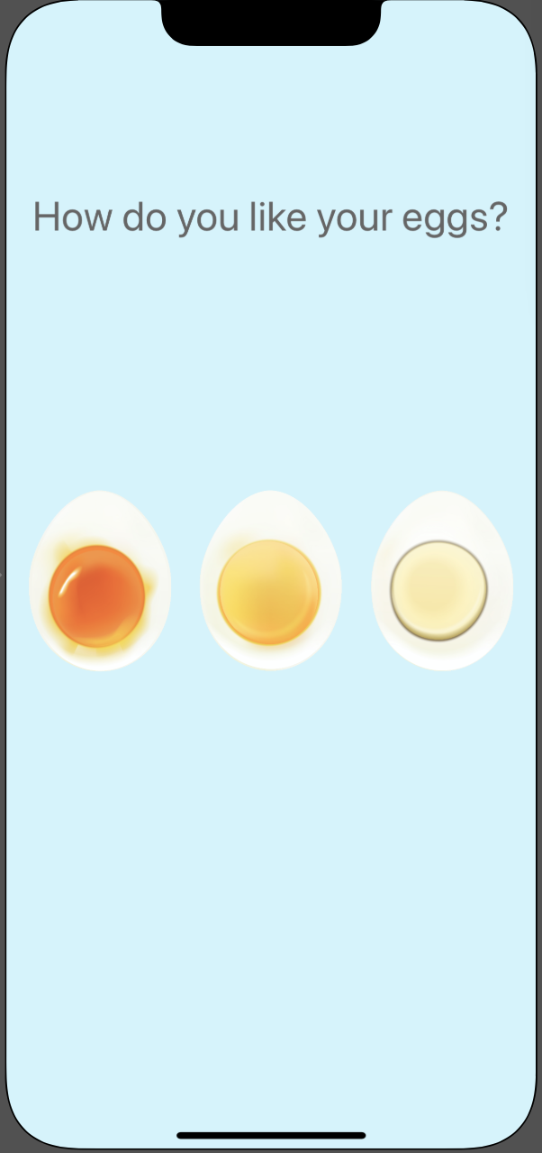
Download The Initial Project From E-learning
Please download the EggTimer.zip file from E-learning or following links:
https://elearning.pu.edu.tw/learn/path/download.php?path=SP5q6XyWcUX5jMKY13Phu9LpHLmFKeHUc7YVc0UWX3ZAGUiYzlZZbVOMJvcc4Y1c
Unzip the file and run the project.

Slide 5

Observer The Initial Project
Use the knowledge we have learned from previous lessons to make some modifications!

Slide 6
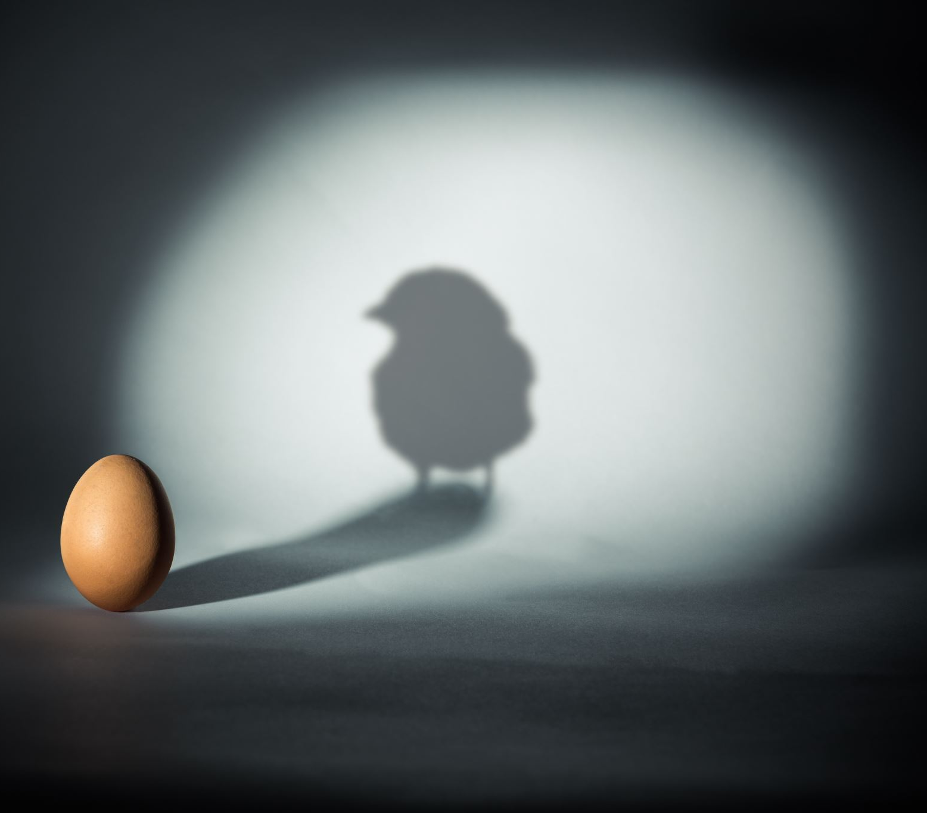
Let The Egg Button Appears
The initial project’s Egg View contained Egg Button and Egg ImageView, but we can not see the button yet.
Please change the hierarchy of Buttons and ImageViews to layout the Buttons and its text!

Slide 7
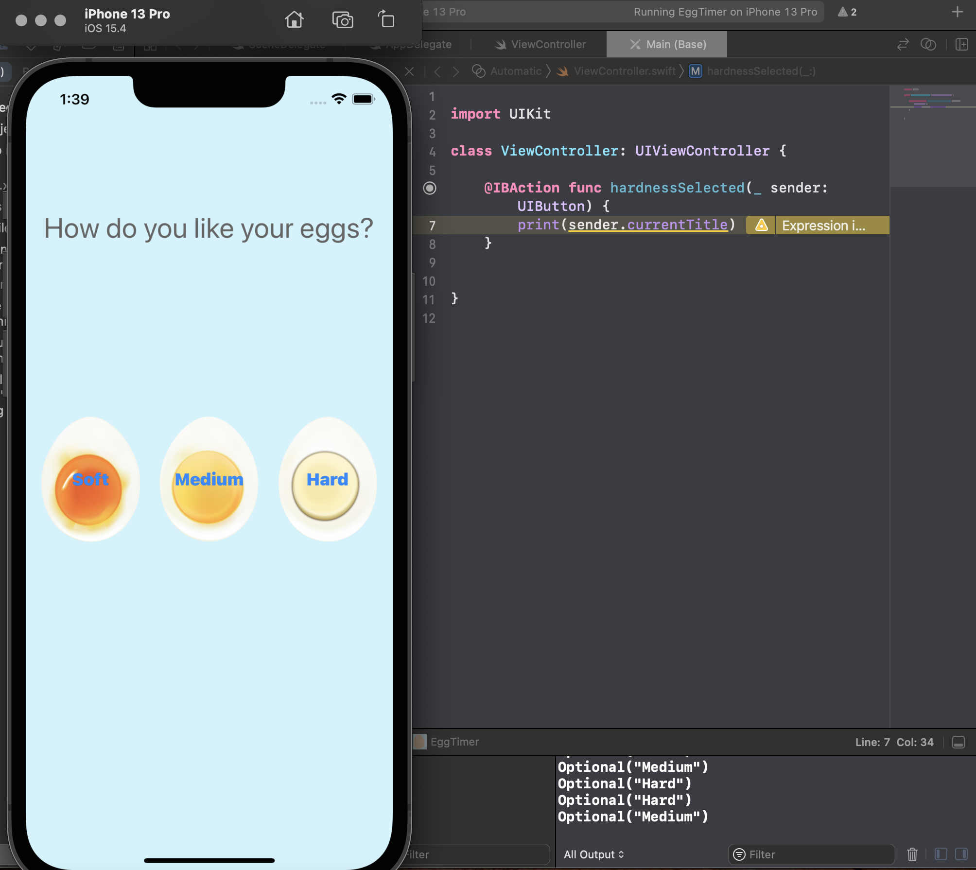
Challenge
Please Create a single IBAction called hardnessSelected and make sure that it's linked to all three buttons: Soft, Medium, and Hard (use touchup or touch down, and select Type as UIButton).
Write some code, so that when you run the app and when you click on each of the buttons, it should print the Soft, Medium or Hard, namely the titles of each of these buttons depending on which one you pressed.
Hint: you can use the sender.currentTitle to get the current clicked button’s title.

Slide 8

Now That We Can Get The Sender’s Attributes and Know Which Buttons We Clicked…
We may want to control our app to have different reaction when user clicks various buttons.

Slide 9
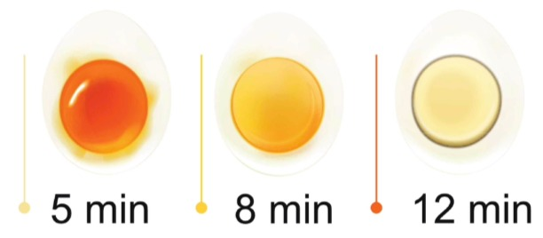
How to Cook An Egg?
After doing a lot of research eating a lot of eggs, we've come to the realization that a soft egg should take about five minutes to boil, a medium egg about eight, and a hard egg about 12 minutes.

Slide 10
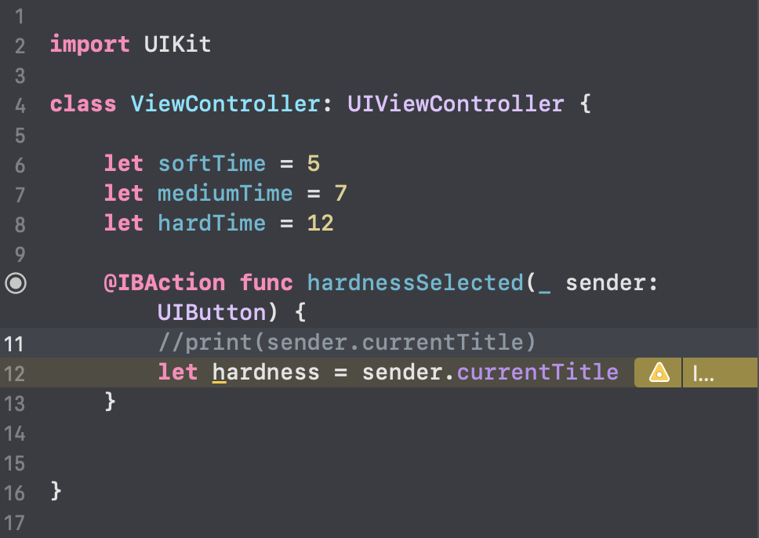
Set The Cook Time and Store The Titles
We can create three constants called softTime, mediumTime and hardTime, set the value to be 5,7 and 12.
We can also declare a constants to store the value of sender.currentTitle for remanding which button user has clicked.

Slide 11
Difference Between Let and Var – Quick View
Let
Var
Immutable
Mutable
Constants
Variables

Slide 12
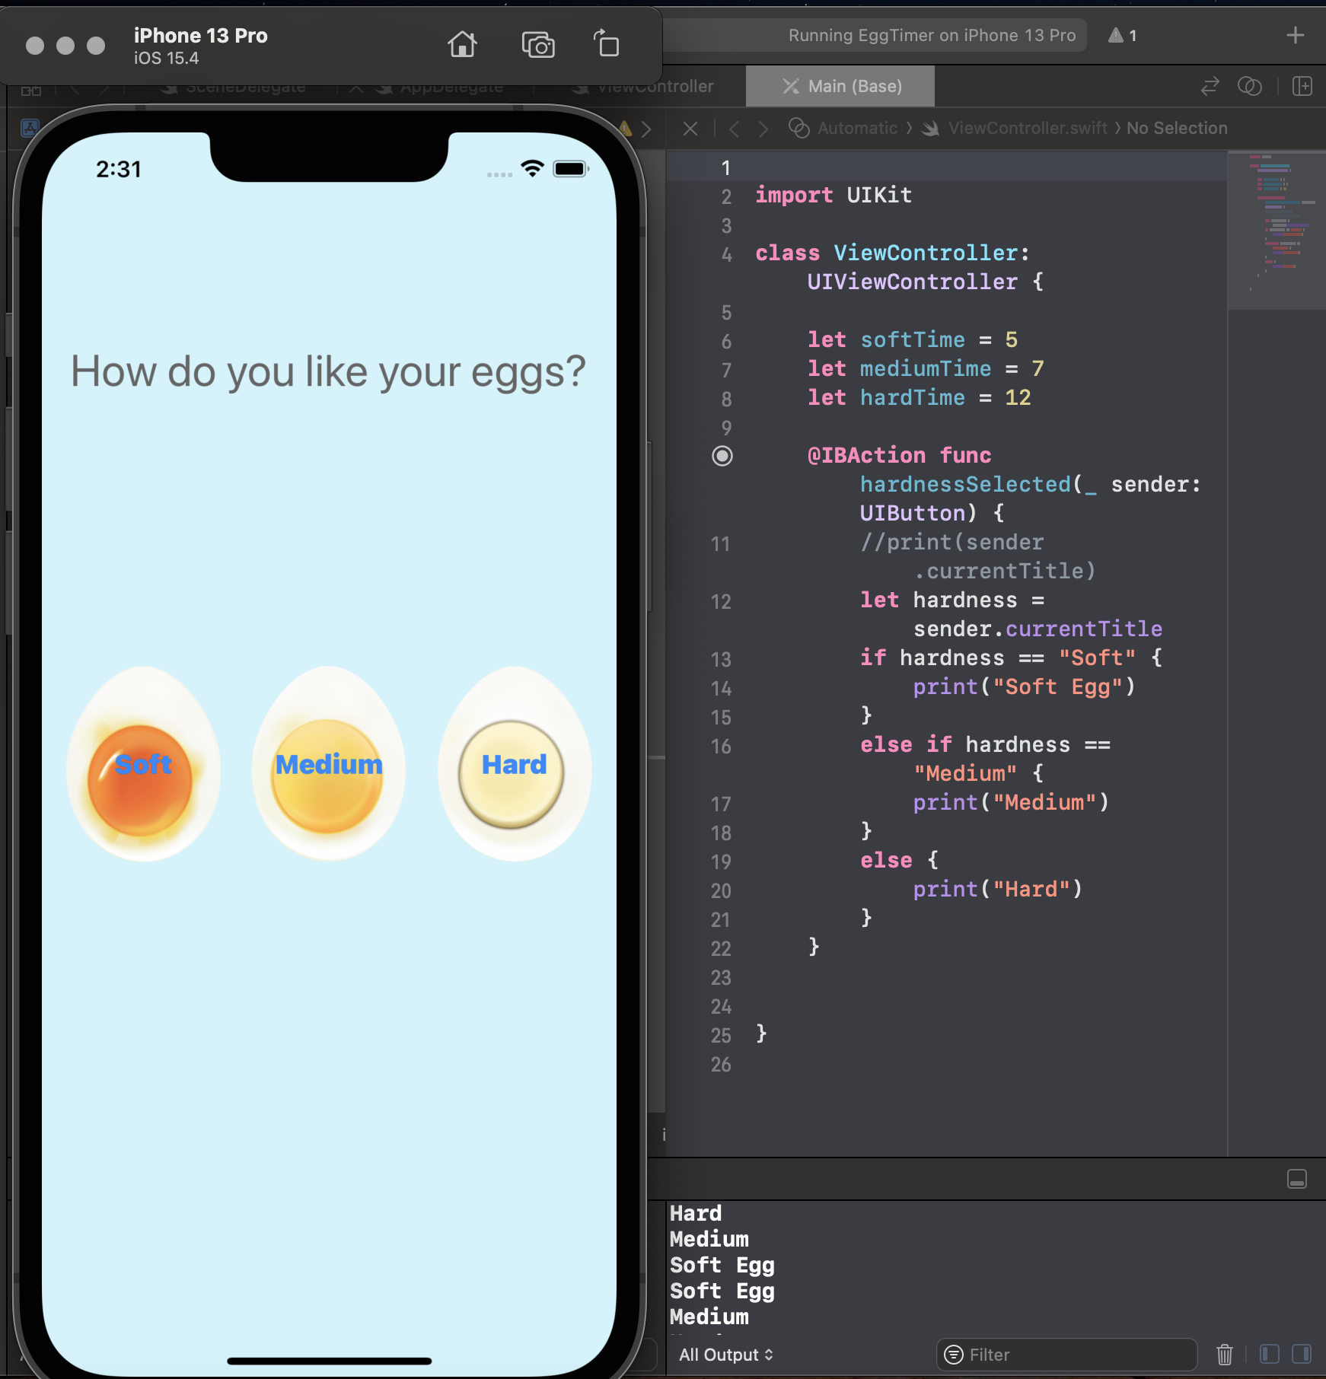
Challenge
How can we print the cook time: 5 if the hardness that was selected by the user was soft, and 7 if they selected medium, and 12 if they selected hard?
Hint: use the IF … ELSE or SWITCH statements(you can refer to the Swift_Cheat_Sheet.pdf from E-learning)

Slide 13
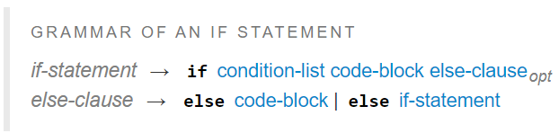
IF…ELSE Statements
https://docs.swift.org/swift-book/LanguageGuide/ControlFlow.html
if condition 1 {
statements to execute if condition 1 is true
} else if condition 2 {
statements to execute if condition 2 is true
} else {
statements to execute if both conditions are false
}
if condition {
statements to execute if condition is true
} else {
statements to execute if condition is false
}
if condition {
statements
}

Slide 14
SWITCH Statements
https://docs.swift.org/swift-book/LanguageGuide/ControlFlow.html
switch control expression {
case pattern 1:
statements
case pattern 2 where condition:
statements
case pattern 3 where condition, pattern 4 where condition:
statements
default:
statements
}
var randomNumber = Int.random(in: 0...10) switch randomNumber { case let x where x % 2 == 0: print("\(randomNumber) is even") case let x where x % 2 == 1: print("\(randomNumber) is odd") default: print("Invalid") }

Slide 15
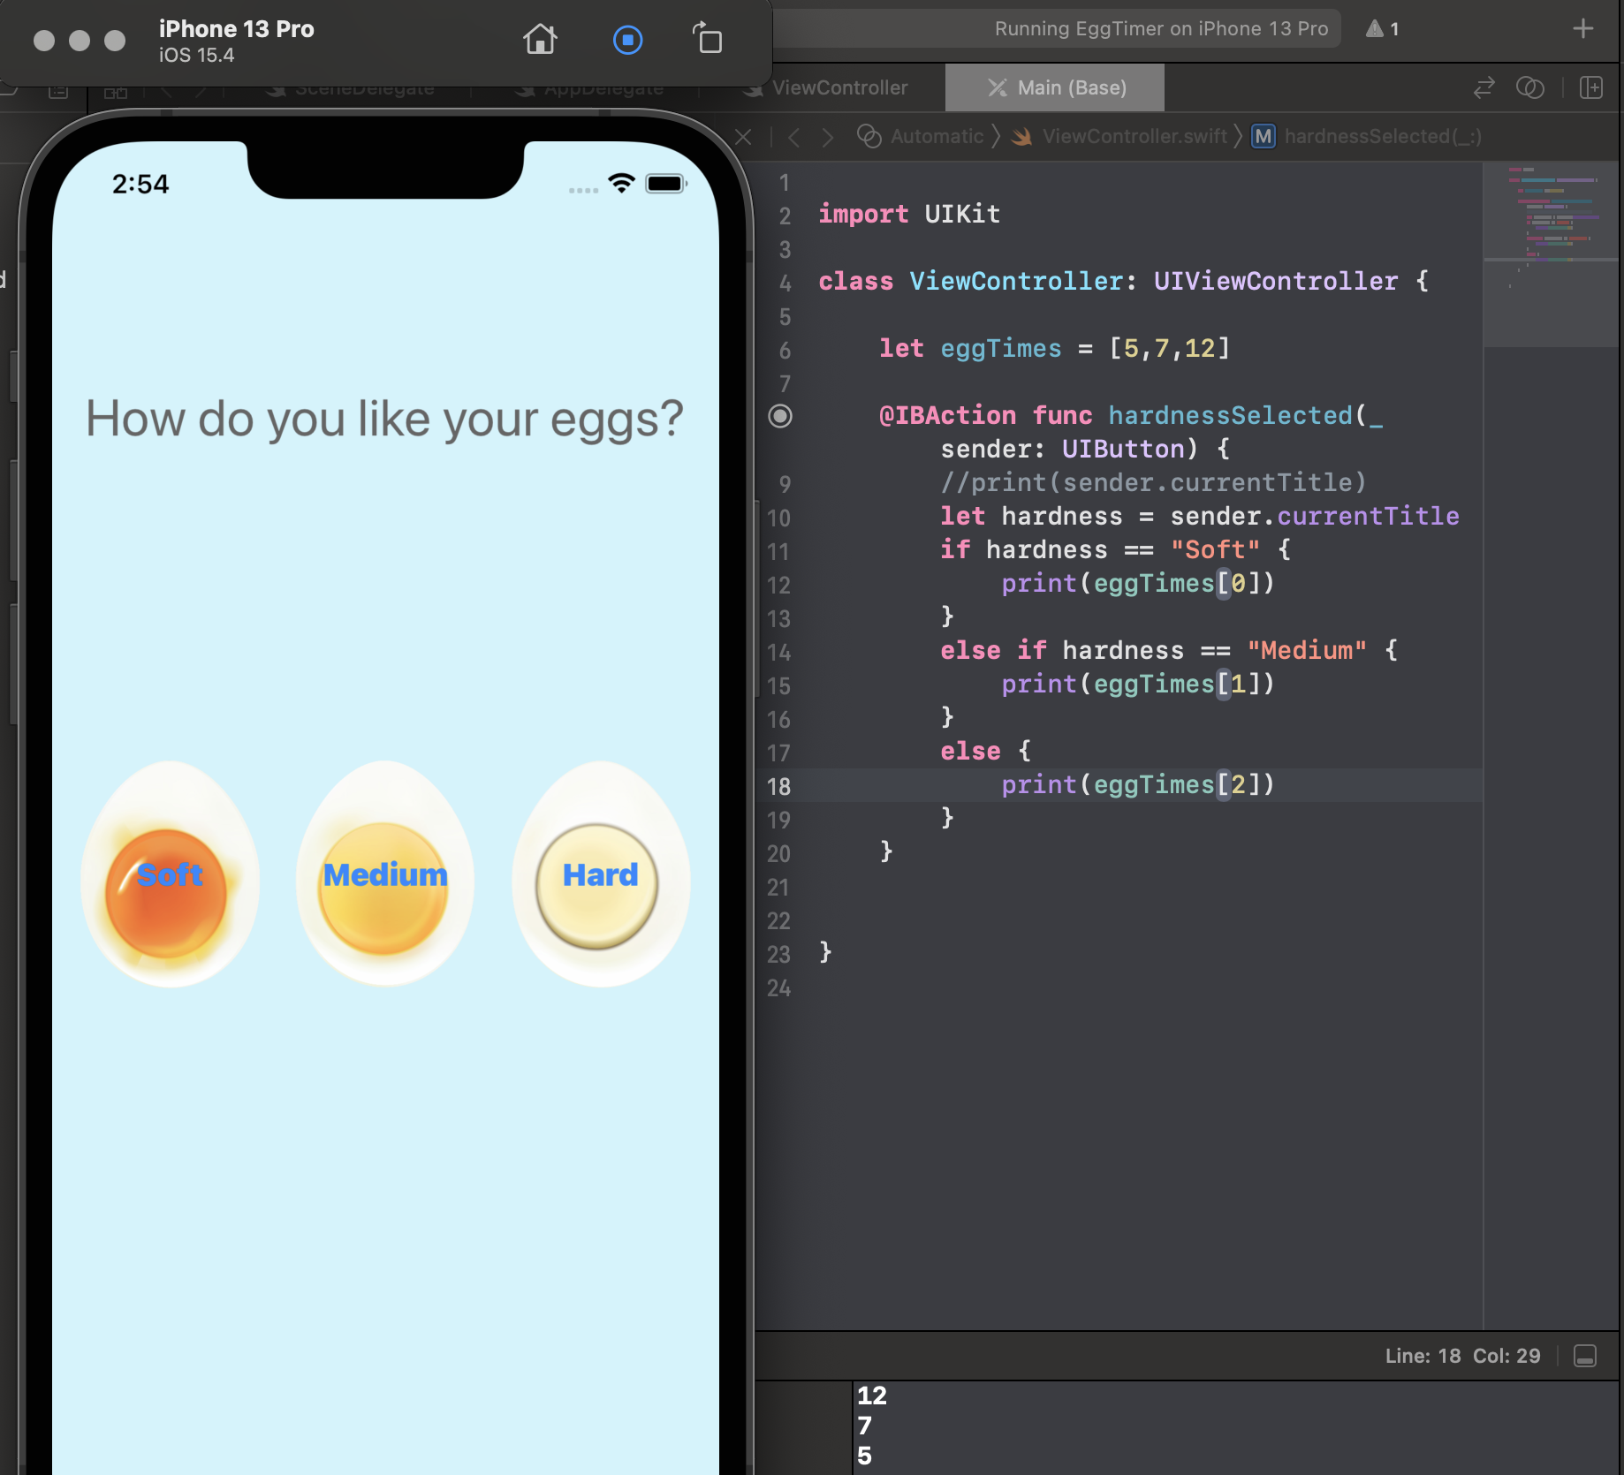
Store The Cook Time in An Array
It’s not convenient to declare so much variable or constants, we can set the egg’s cook time in an array.
But we will notice that we need to handle the relationship between index and the value by our “smart” brains.

Slide 16
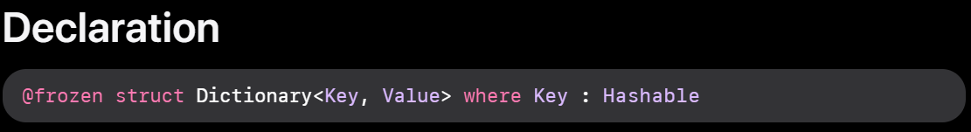
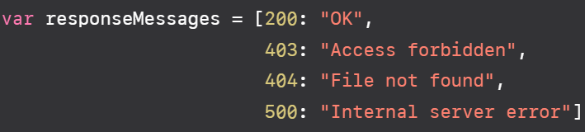
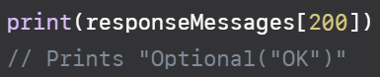
Another Collection: Dictionary
https://developer.apple.com/documentation/swift/dictionary
There is another type of collection: dictionary, like a real-world dictionary, you can use the key to map the value.

Slide 17
Store The Cook Time in A Dictionary
We can store the cook time by the key as same as the hardness constant and associated it with the cook value.
We may want to remove the IF…ELSE statements because we can use key(hardness) to find the value.
But when we make the action, we will get an Error!

Slide 18
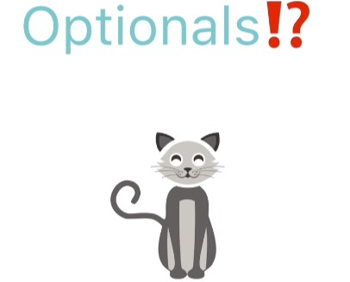
What Is Optional?
Schrödinger's cat

Slide 19
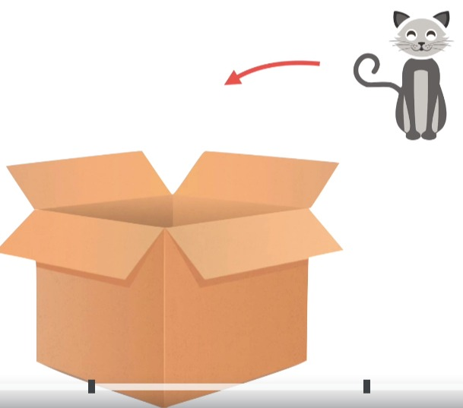
The C A T
If we have cardboard box and let the cat goes into the box, we're pretty sure that currently, we have a real cat in the box.

Slide 20

The Poison
During the hectic time of moving, we also accidentally popped a bottle of poison into the same box as the cat.

Slide 21

Package Up The Box
We package box up and we kind of moved around in the van, shake it around, and the poison bottle might be broken.
We now basically have an optional cats.

Slide 22

Cat?
We have a cat with a question mark at the end of it. We don't know if Fluffy is dead or alive.

Slide 23

CAT!
If we were to force open or unwrap our box and see what's inside

Slide 24

Alive Or Dead?
Cat
Nil

Slide 25
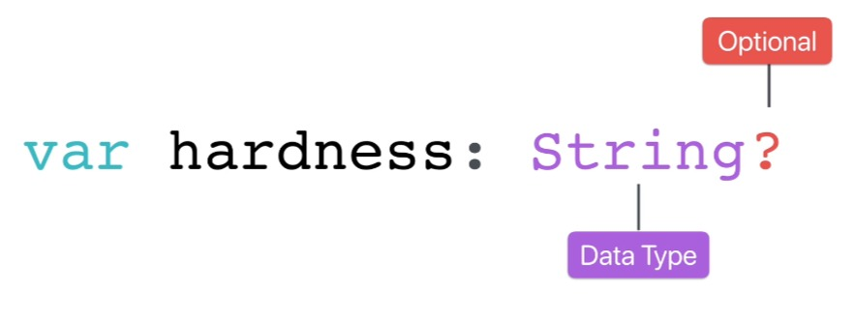
Optional

Slide 26
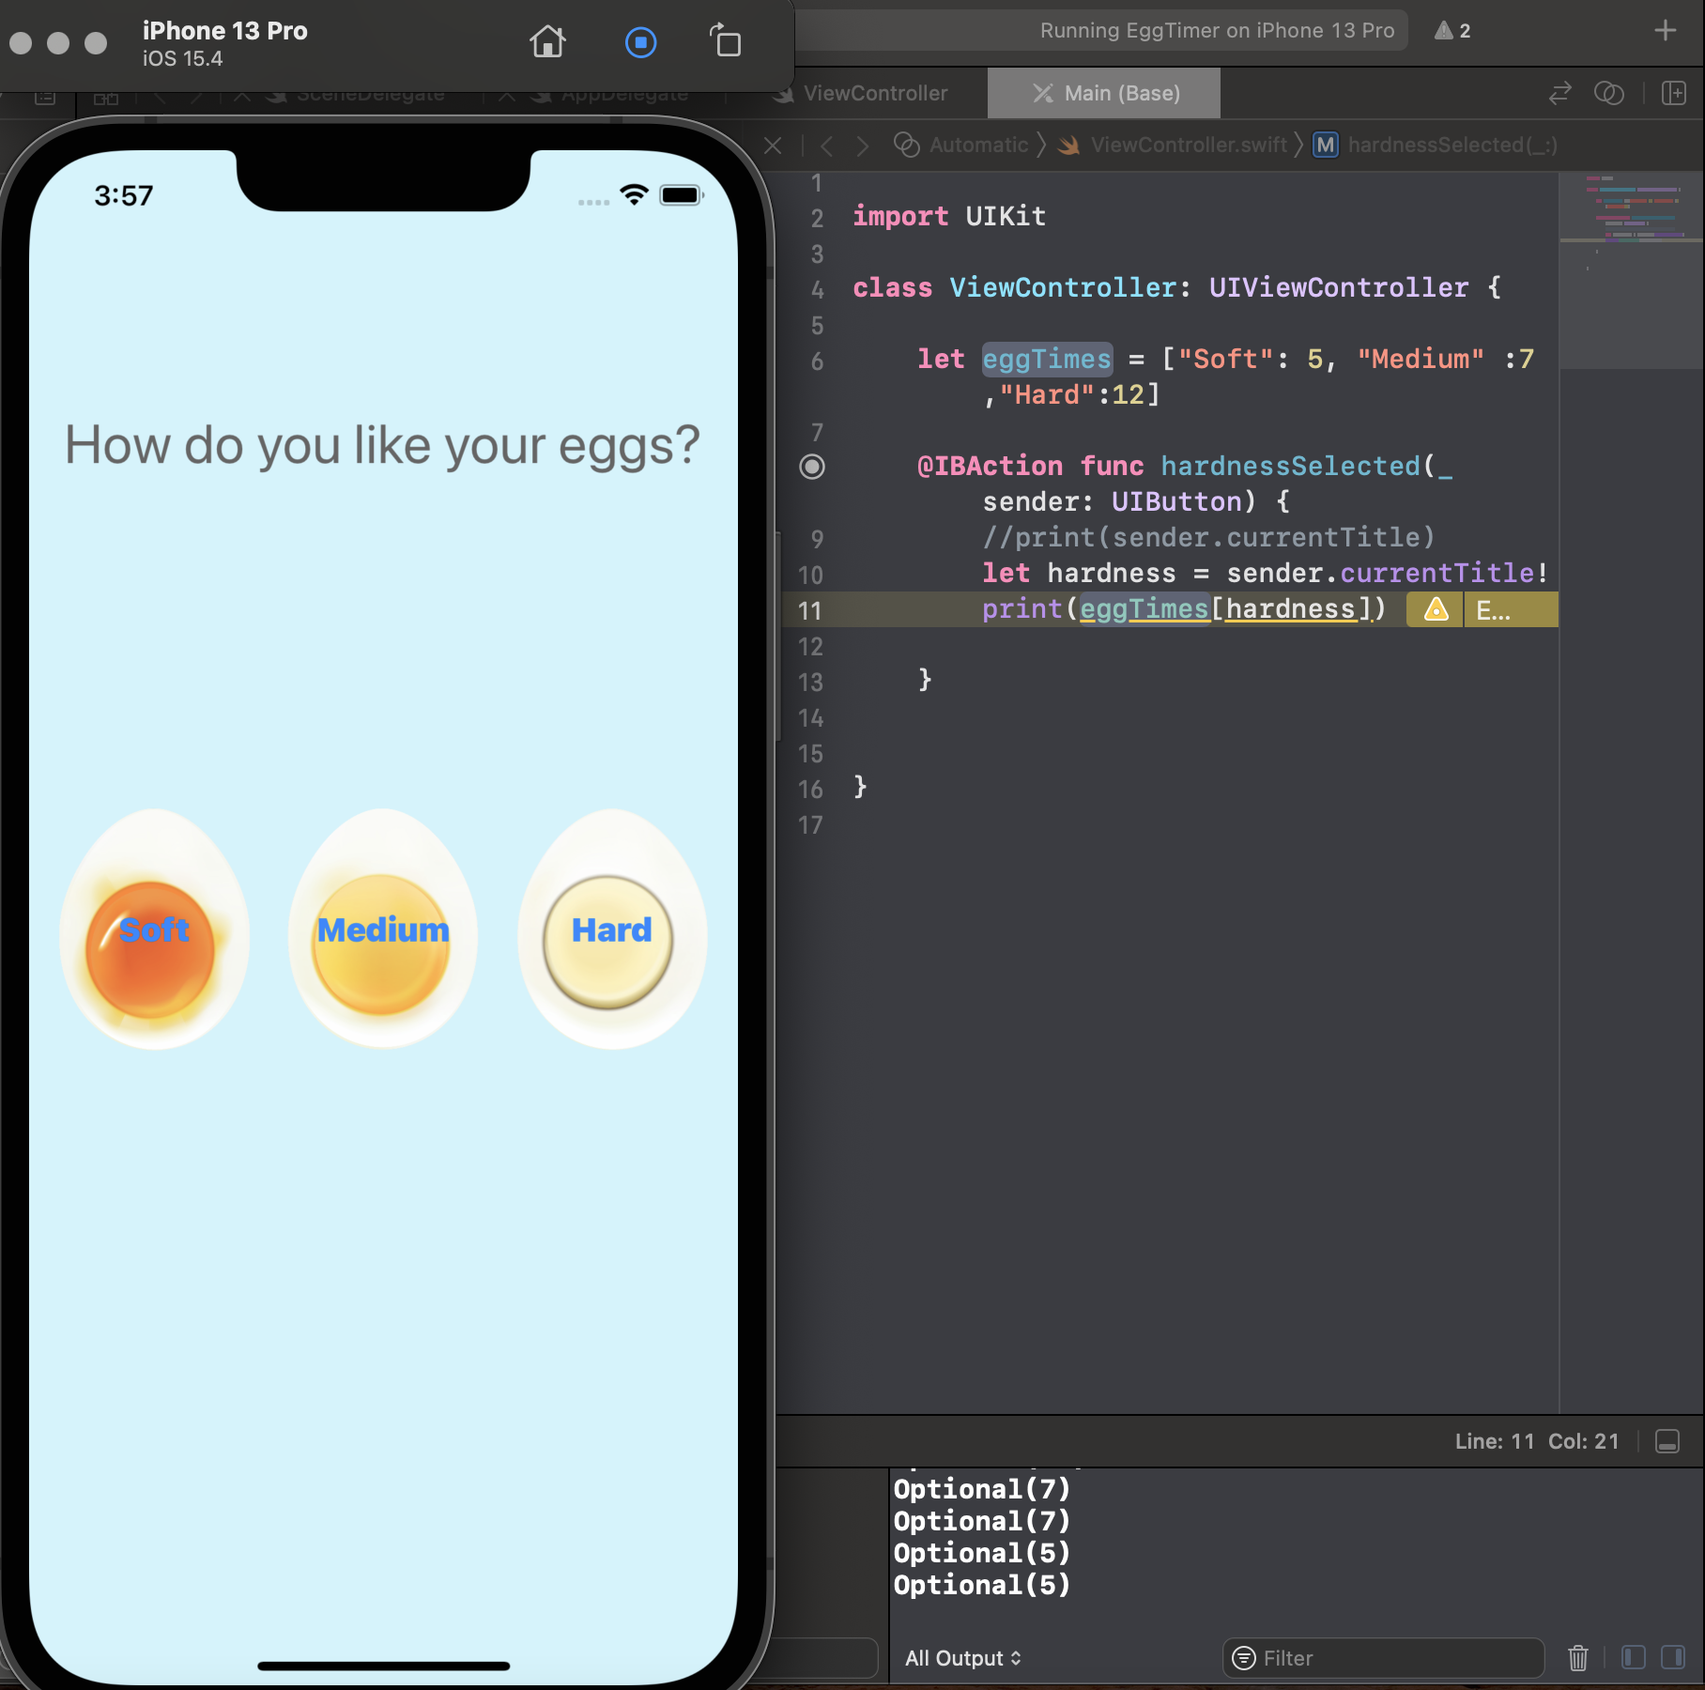
Back To Our App
All our dictionary keys are solid strings and not optional strings.
we must convert this hardness which comes from sender.currentTitle into a nonoptional.
This essentially says that “閉嘴，別吵，XCode"

Slide 27
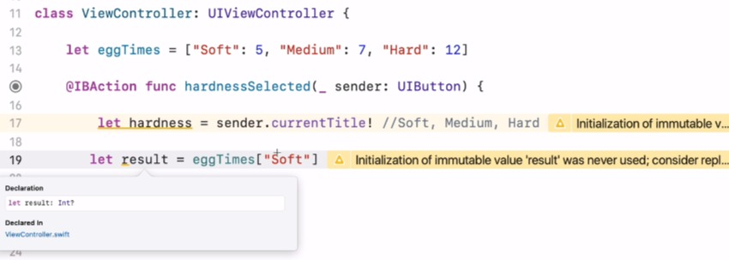
See Optional Again…
let result = eggTimes, and if I hold an option and click on result, we can see that the result is an optional integer.
When Swift try to grab an integer out of our dictionary, it doesn't know if we'll be able to find one using this key.

Slide 28
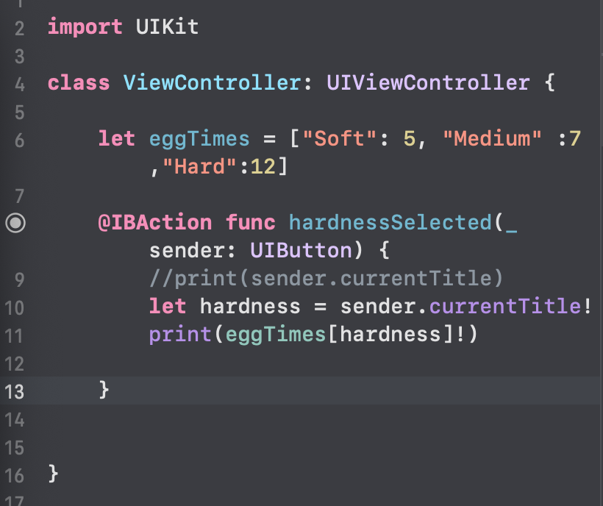
Let Xcode Shut Up Again
if we wanted to not be an optional, then we, again, hit the exclamation mark.

Slide 29
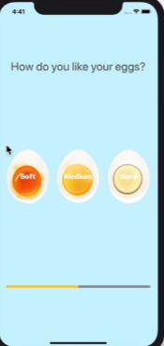
Today’s Works
Finish all the challenges and let your EggTimer app can display cook time by user’s action of clicking different buttons.
Next week we will use the Progress Bar to show the timer!

